Slide 1

Turtle Rescue Team AMR Collab
2023

Slide 2
Study Goals
Identify the presence of and characterize antimicrobial resistant bacteria among TRT turtles
Assess the feasibility of using admitted TRT native NC turtle patients as bioindicators of local antimicrobial resistance in the environment

Slide 3
Data Collection
Enrolled admitted TRT native turtles from April to June 2023
Collected data on morphological characteristics, originating location and clinical treatment
Collected intake and discharge cloacal swabs (as was possible) and processed samples for E.coli (and Klebsiella?) and Salmonella

Slide 4
Results

Slide 5
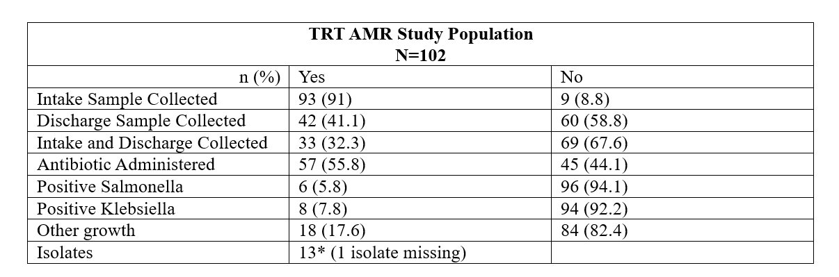
Study Population
Notes:
14 isolates ** 1 isolate missing
1 turtle positive with salmonella at Intake and Discharge with Salmonella (potentially also had Kleb at intake)
Of the other growth, 3 were potentially Kleb at intake → unsure if we have isolates for them

Slide 6
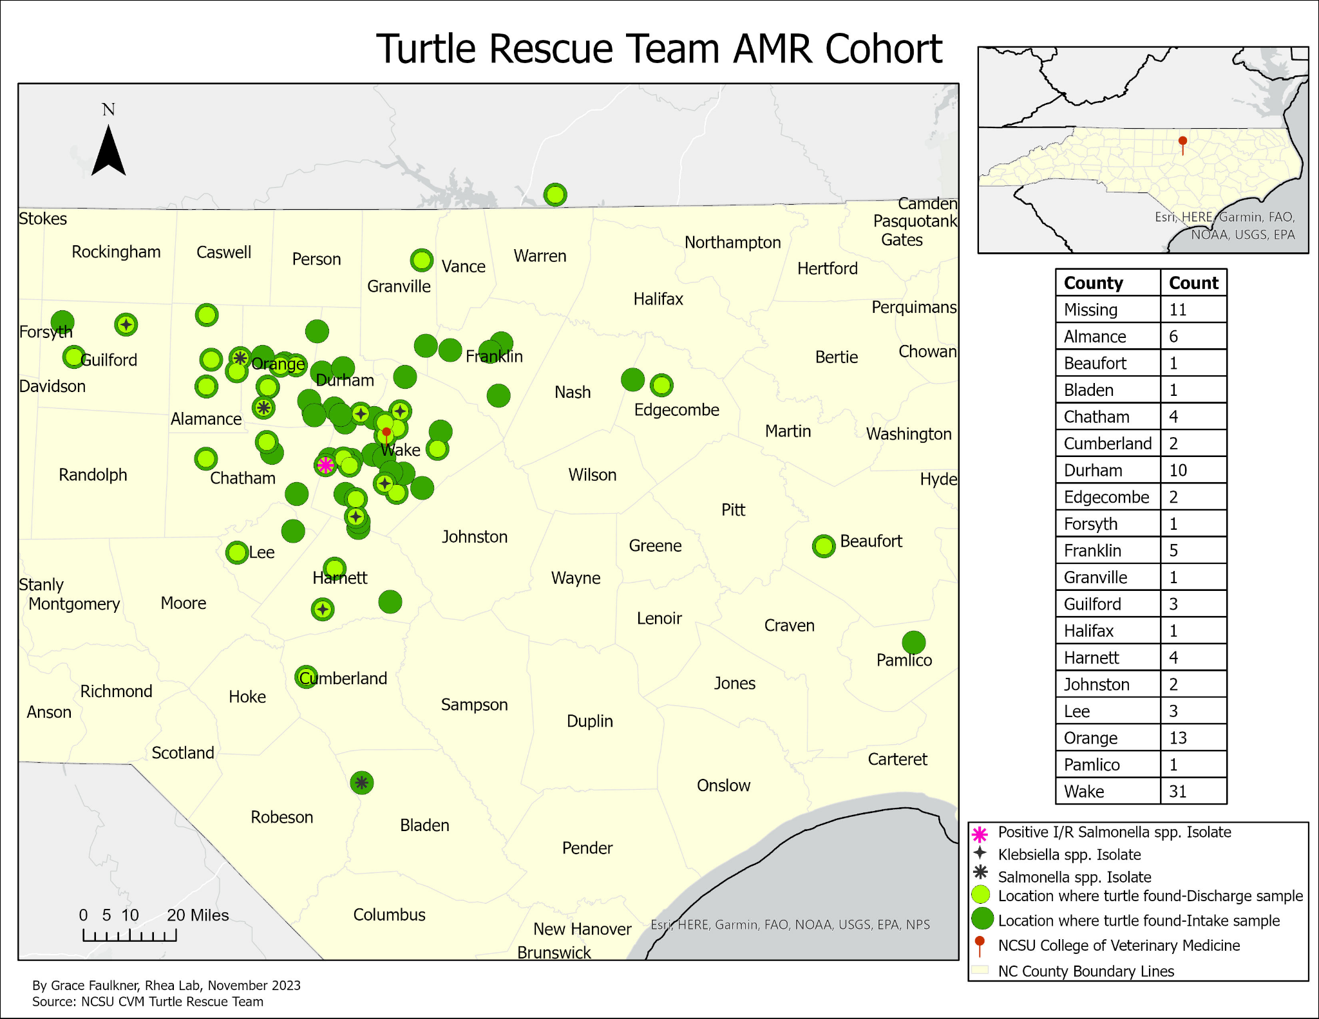
*I/R → Positive Salmonella spp. Sample from Intake and Discharge
Notes:
I/R sample note

Slide 7
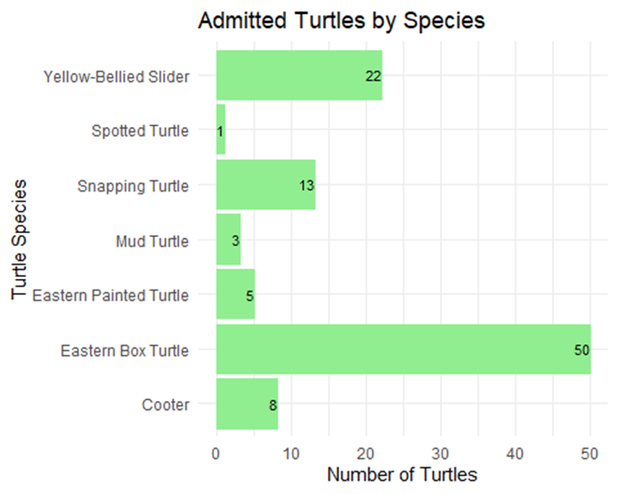
Study Population by Species (N=102)
(21.6%)
(0.9%)
(12.7%)
(2.9%)
(4.9%)
(49.0%)
(7.8%)

Slide 8
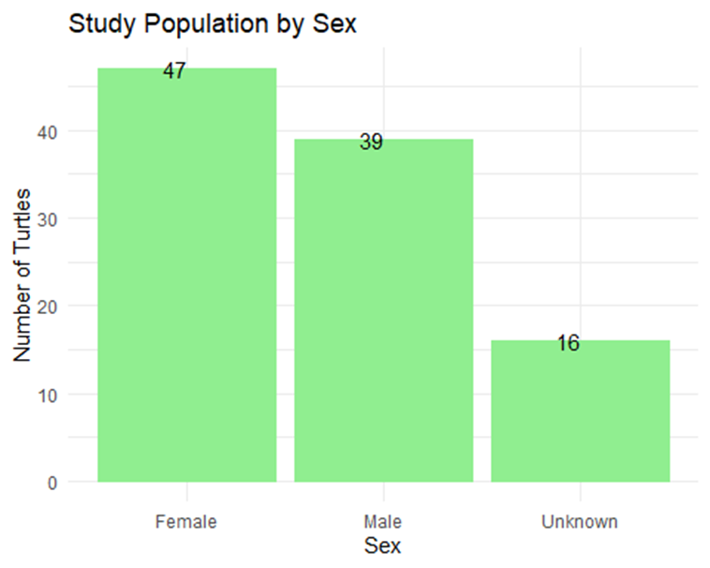
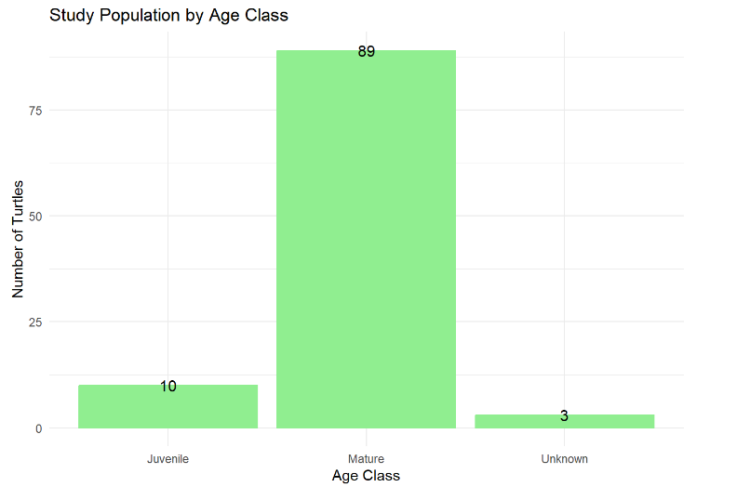
Study Population by Sex and Age Class (N=102)
(87.3%)
(46.1%)
(38.2%)
(15.6%)
(9.8%)
(2.9%)

Slide 9
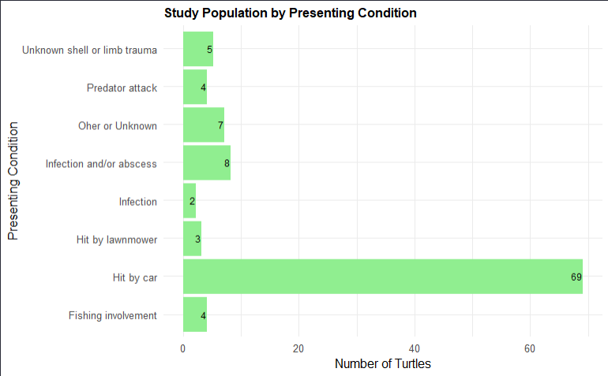
Study Population by Presenting Condition (N=102)
(4.9%)
(3.9%)
(6.8%)
(7.8%)
(1.9%)
(2.9%)
(67.6%)
(3.9%)
(3.9%)

Slide 10
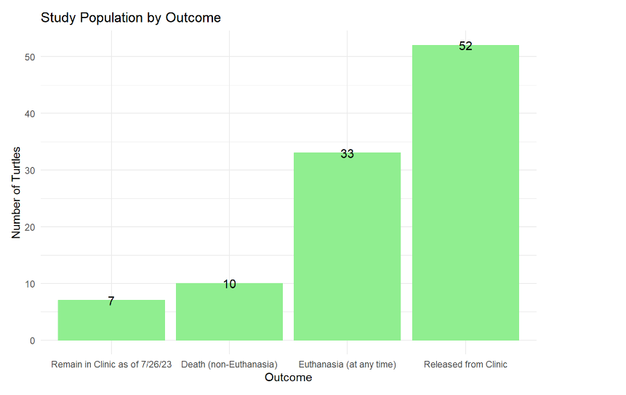
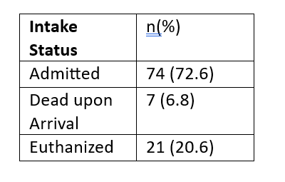
Study Population by Outcome (N=102)
(50.9%)
(32.3%)
(9.8%)
(6.8%)

Slide 11
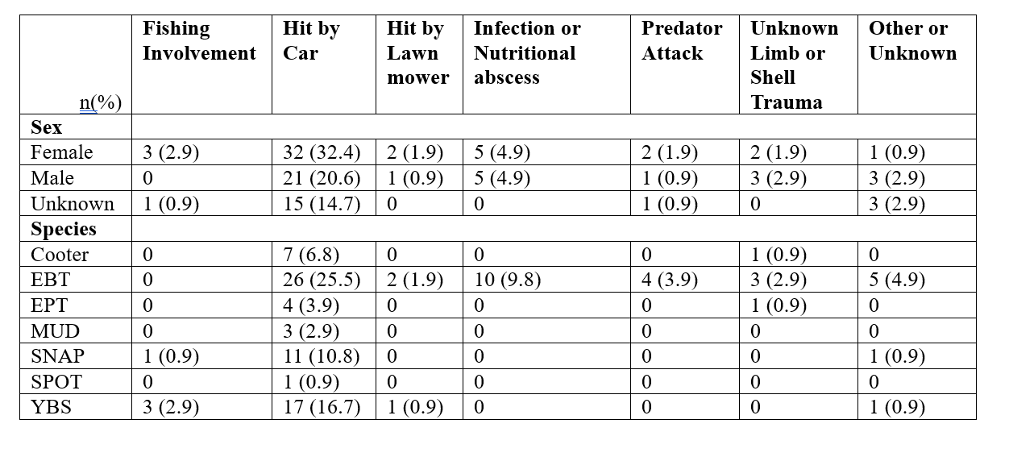
Presenting Condition by Sex, Species

Slide 12
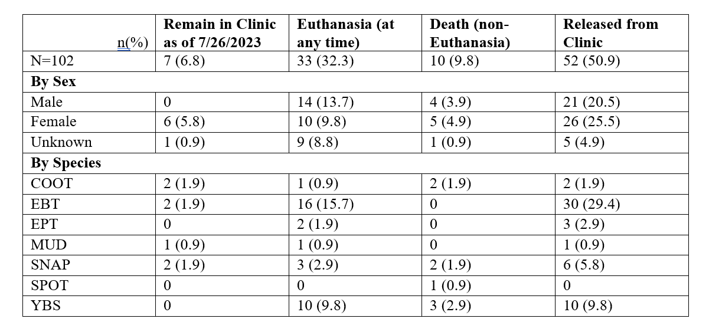
Outcome by Sex, Species

Slide 13
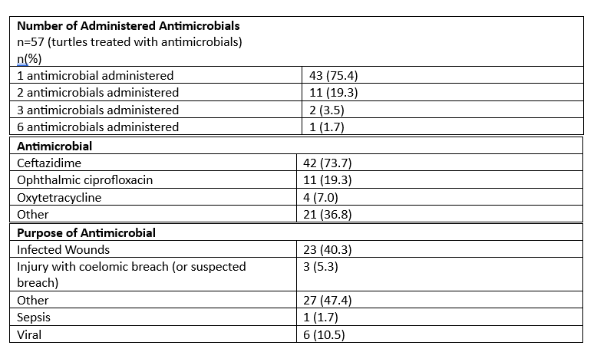

Slide 14
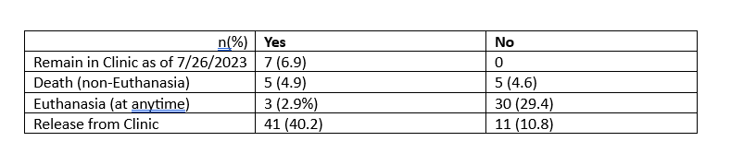
Antibiotic Use by Outcome

